Slide 1
SMART HOME SECURITY SYSTEM
DOOR SENSOR
D
MOTION SENSOR
M
A Combinational Logic Project
Digital Logic Design | Logisim Evolution
SMOKE SENSOR
S
TEAM MEMBERS
Name | Roll Number
Peddinti Sri Parnitha Sai | 2620030312
K. Shanvika Reddy | 2620030321
Yada Sai Priya | 2620030316
A
ALARM
Section: S2

Slide 2
Introduction and Objective
A simple digital circuit that decides when an alarm should turn on
Introduction
Objective
The system monitors four binary inputs: Door (D), Motion (M), Smoke (S) and Armed mode (A).
Each input is 0 (inactive) or 1 (active).
The output ALARM becomes 1 when smoke is detected, or when an armed system detects a door opening or motion.
The circuit is combinational: no memory, output depends only on current inputs.
Translate the written alarm requirements into a Boolean expression.
Simplify the logic and implement it with minimum gates.
Build and verify the circuit in Logisim Evolution against the truth table.
Learning simulation, not a certified alarm system.

Slide 3
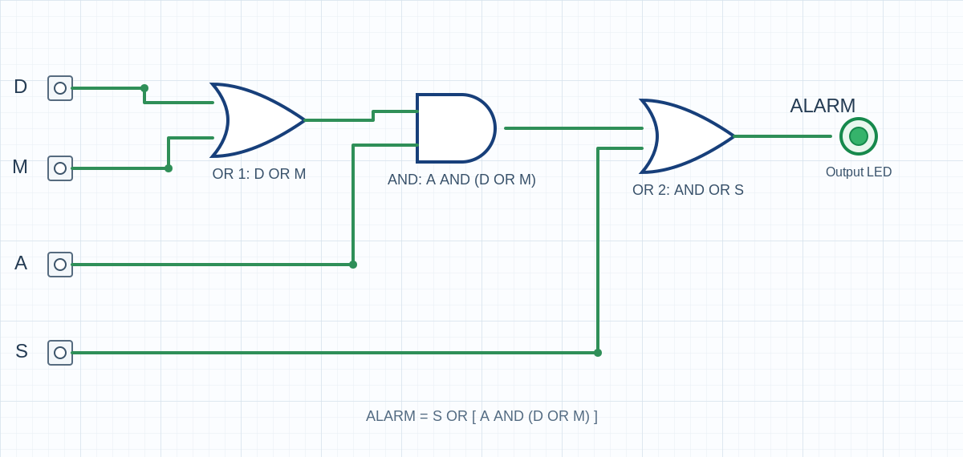
Theory and Logic Circuit
Specification to Boolean expression to gate circuit
Design rules
Smoke triggers the alarm regardless of armed mode.
Door or motion triggers it only when armed.
Otherwise the alarm stays off.
ALARM = S + A(D + M)
+ = OR, multiplication = AND. Expanded: S + AD + AM
Gates used: 2 x OR, 1 x AND
OR1 = D OR M; AND = A AND OR1; OR2 = AND OR S (output = ALARM)

Slide 4
Circuit Design in Logisim
Implementation and working of the circuit
1
Place pins: Four input pins labelled D, M, A, S.
2
First OR gate: Connect D and M.
3
AND gate: Connect the OR output and A.
4
Second OR gate: Connect the AND output and S.
5
Output: Connect to an output pin / LED named ALARM.
Circuit layout - replace with your Logisim screenshot
Working
Poke each input between 0 and 1. Smoke alone turns the LED on; door or motion turns it on only when A = 1.

Slide 5
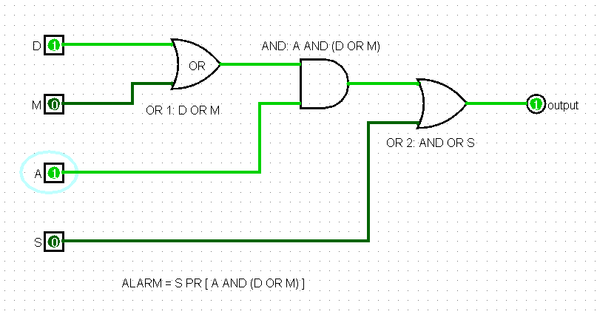
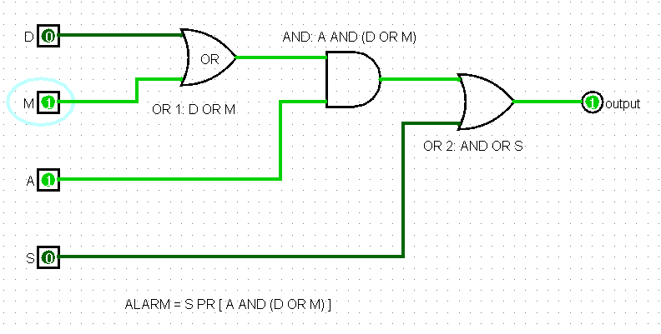
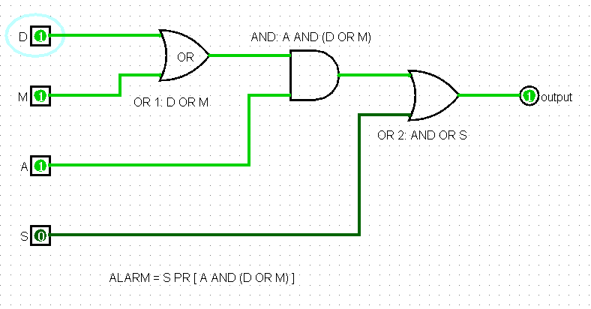
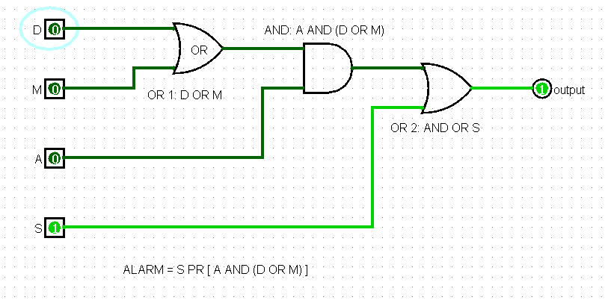
When D and A are activated
When M and A are activated
When D A M are activated
Only when Smoke is detected

Slide 6
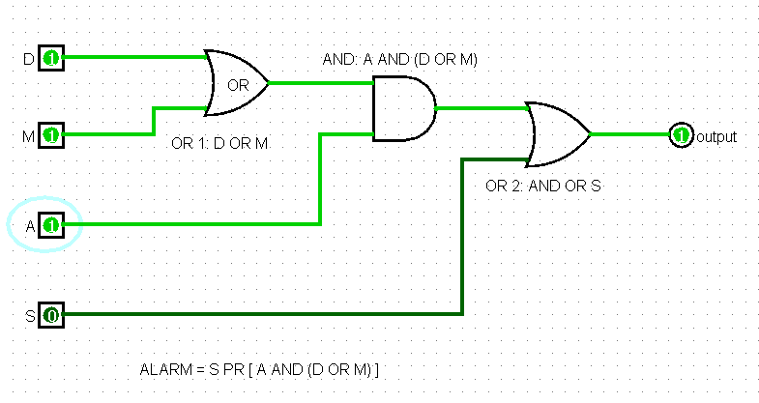
Simulation Results
Logisim screenshots, input-output combinations and truth table
D | M | S | A | ALARM
0 | 0 | 0 | 0 | 0
0 | 0 | 0 | 1 | 1
0 | 0 | 1 | 0 | 0
0 | 0 | 1 | 1 | 1
0 | 1 | 0 | 0 | 0
0 | 1 | 0 | 1 | 1
0 | 1 | 1 | 0 | 1
0 | 1 | 1 | 1 | 1
1 | 0 | 0 | 0 | 0
1 | 0 | 0 | 1 | 1
1 | 0 | 1 | 0 | 1
1 | 0 | 1 | 1 | 1
1 | 1 | 0 | 0 | 0
1 | 1 | 0 | 1 | 1
1 | 1 | 1 | 0 | 1
1 | 1 | 1 | 1 | 1
Insert Logisim simulation screenshots here
(e.g. Smoke only, Door armed, Door disarmed)
Representative test cases
D=1, A=0, S=0 gives ALARM=0 (door open but disarmed)
D=1, A=1, S=0 gives ALARM=1 (door open while armed)
S=1, A=0 gives ALARM=1 (smoke, even disarmed)

Slide 7
Conclusion and Applications
Summary, applications and possible improvements
Outcome
Applications
Improvements
Designed a Smart Home Security System with four binary inputs.
Derived and simplified ALARM = S + A(D + M).
Built with only two OR gates and one AND gate.
Output verified against all 16 truth-table rows in Logisim.
Home and office intrusion alarms.
Fire/smoke alert panels.
Basis for decision logic in access control and industrial safety interlocks.
Add a 2-to-1 multiplexer to switch between basic and strict alarm policies.
Add a decoder to drive separate status LEDs (safe, motion, door, alarm).
Add a latch or timer so the alarm stays on until reset.

